Slide 1
Machine Learning
Machine Learning Introduction to Machine Learning by Kumar Anurupam is licensed under a Creative Commons Attribution-4.0 International License.
SVM Introduction, Geometric Intuition
CS 3104 Fall 2019
Lecture Slides by Kumar Anurupam

Slide 2
Learning Objectives
After completion of today’s session you will be able to:
Explain the concept of SVM geometrically.
Discuss the advantages and disadvantages of SVM.

Slide 3
SVM introduction
In machine learning, support-vector machines (SVMs, also support-vector networks) are supervised learning models with associated learning algorithms that analyze data used for classification and regression analysis.
An SVM model is a representation of the examples as points in space, mapped so that the examples of the separate categories are divided by a clear gap that is as wide as possible.
New examples are then mapped into that same space and predicted to belong to a category based on the side of the gap on which they fall.
This is achieved by using the concept of hyperplane which acts as a decision boundary separating the classes.

Slide 4
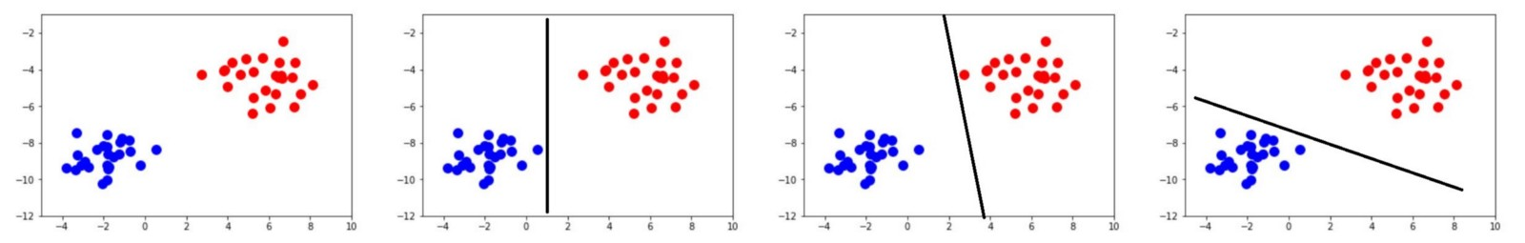
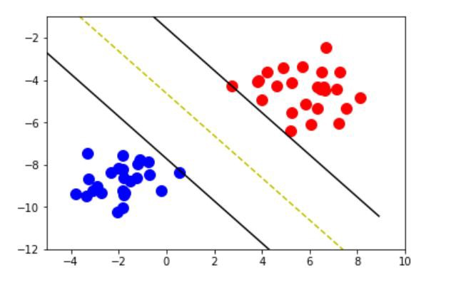
Why SVM?
We have many classifications algorithms like logistic regression, KNN, Decision Tree etc. Those algorithm classify the data as follows.
But, the SVM algorithm classifies the data as below.
SVM tries to minimize the generalization error by maximizing the margin.

Slide 5
Applications of SVM
It is used in several applications like
Hand-Written digit recognition
Object Recognition
Speaker identification
Time-series prediction
Cancer tumours classification

Slide 6
Advantages of SVM
SVM supports non-linear separation using kernel tricks, by which SVM tries to avoid overfitting and underfitting.
It works really well with clear margin of separation
It is effective in high dimensional spaces.
It is effective in cases where number of dimensions is greater than the number of samples.
It uses a subset of training points in the decision function (called support vectors), so it is also memory efficient.
SVM can be used for both classification and regression problems. Eventhough SVM is mainly used for classification problems, SVR is used for regression problems.

Slide 7
Disadvantages of SVM
It doesn’t perform well, when we have large data set because the required training time is higher
It also doesn’t perform very well, when the data set has more noise i.e. target classes are overlapping
SVM doesn’t directly provide probability estimates, these are calculated using an expensive five-fold cross-validation.

Slide 8
References
[1] https://en.wikipedia.org/wiki/Support-vector_machine

Slide 9
Thanks

